Slide 1
Trippy Japan Web Design Report
Moe Kiuchi
Nguyen Thi Minh Tam
Vrajesh Rawal
Tran Thu Thao
Nguyen Thieu Huy
Ayumi Shoji

Slide 2
Agenda Style
01
Brief Introduction
Introduce our project
02
Motivation
Why do we choose this company
03
Strategy
How we solve Trippy problem
04
Design
How we demonstrate our strategies via the web

Slide 3
INTRODUCTION
What is Trippy ?

Slide 4

Why we choose Trippy
Facing a seasonal problem which is the drought of revenue especially from January to March
\
Trippy Japan is a Japanese domestic travel agency

Slide 5
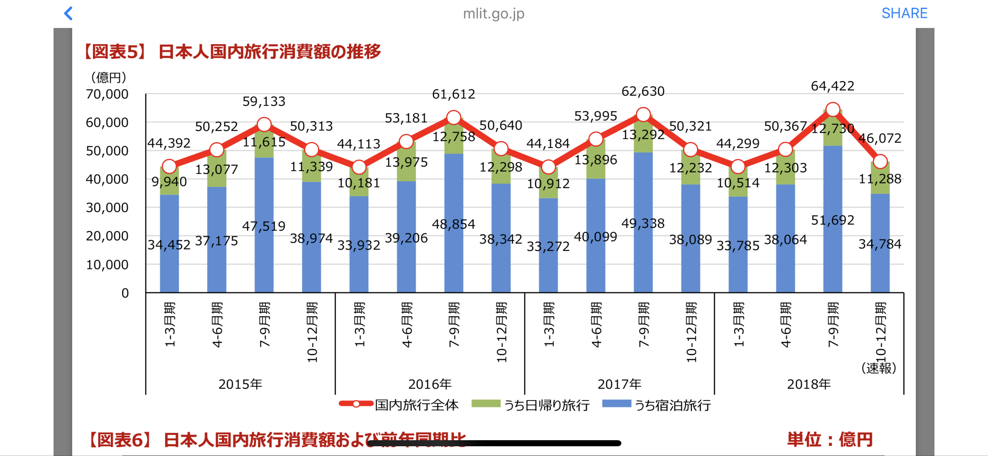
The Number of Domestic Travelers

Slide 6
OUR STRATEGIES
Created Trippy Japan webpage
Offer day tour deals
Have partnerships with other companies
Using the ad banners
Promote and sell the products online
Attract more customers that have limited budgets and limited time
Promote “Day Tour” deals and the company itself by using ad banners
Raising awareness

Slide 7

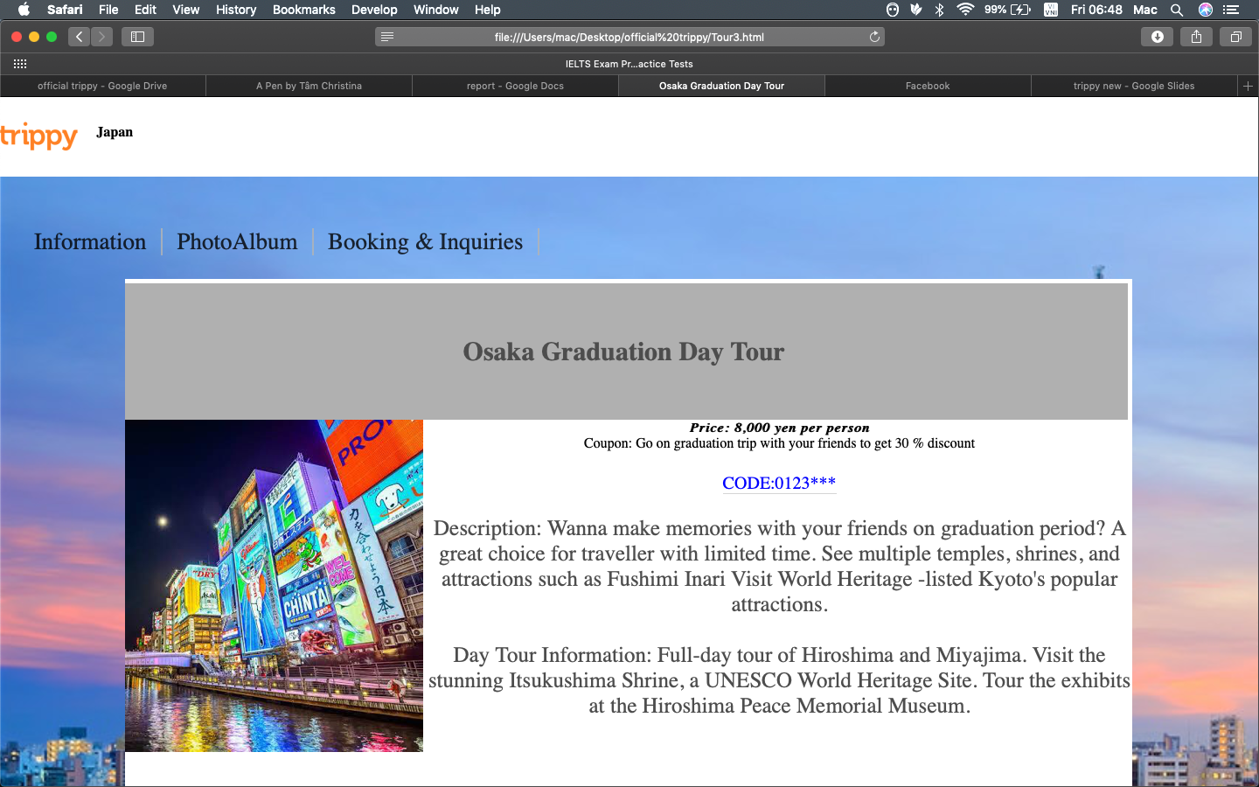
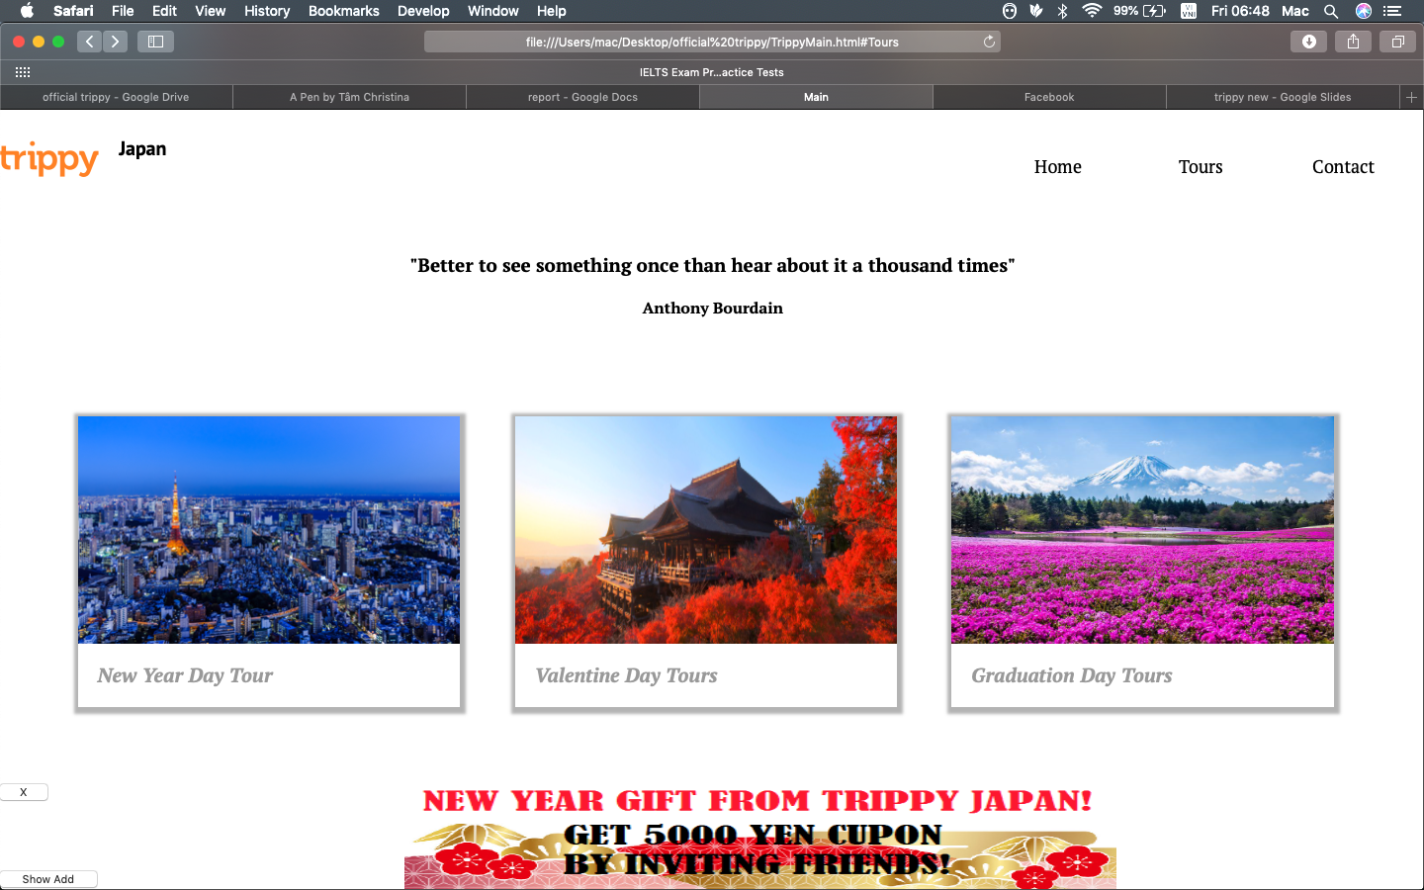
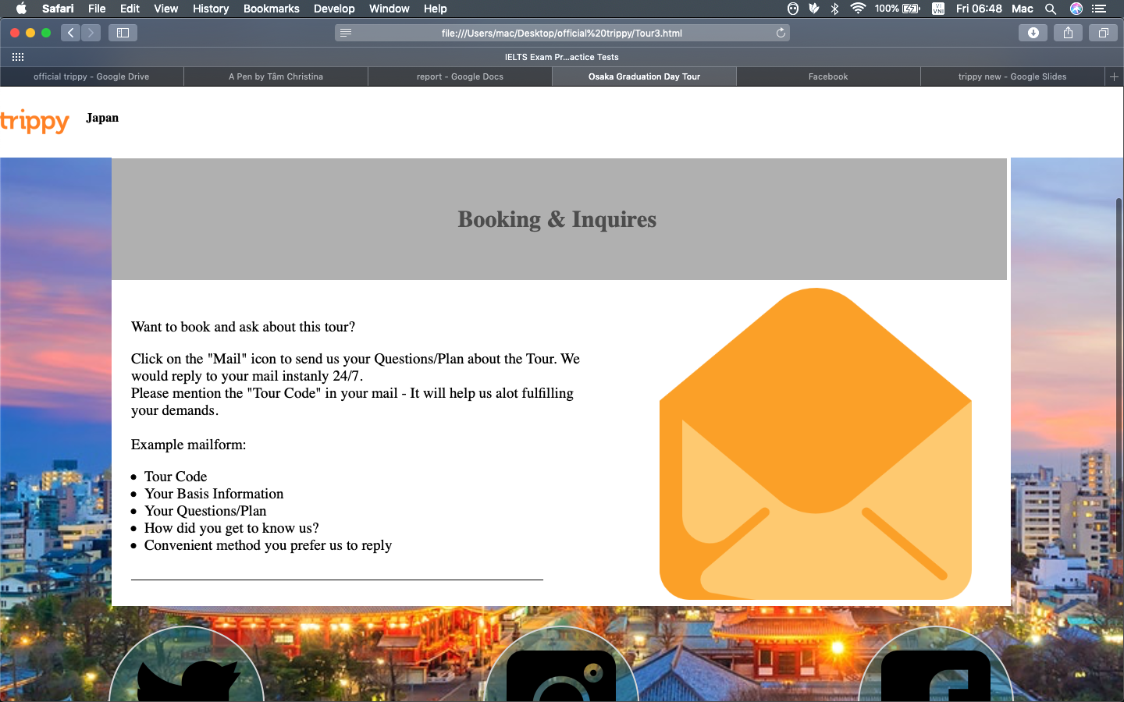
Web Design
Our primary focus is efficiency and simplicity.

Slide 8
Features
-40
Home
01
Accessibility
Tours
02
Booking system on Gmail
Contact
03
Social Media Platforms for other business opportunity

Slide 9
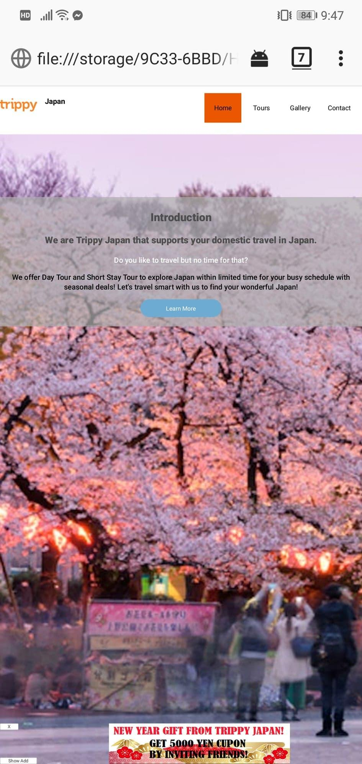
Mobile design
While coding, we continuously check on the responsive design mode to make our design friendly and eye-catching
In order to expand our usage, we made sure to make it mobile friendly
In order to expand our usage, we made sure to make it mobile friendly
Reaching as many people as we can is our goal

Slide 10
Thank you for listening !

